Slide 1
FORENSIC DENTAL X-RAY IMAGE ENHANCEMENT USING CLAHE AND FAG TO DETERMINE AGE AND GENDER
DOMAIN: DEEP LEARNING
GUIDE: MRS P DEEPA
MEMBERS: KAVYA VR
DAHLIA RANE P
NANDHINI S

Slide 2
INTRODUCTION
This project presents an improved dental x-ray enhancement technique based on weighted average fusion of contrast limited adaptive histogram equalisation (CLAHE) and fuzzy adaptive gamma (FAG). The proposed technique is applied in three stages. Firstly, grey level intensities with CLAHE are locally applied to image pixels for contrast enhancement. Secondly, the grey level intensities are then globally transformed into membership planes and modified with the FAG operator for the same purposes. Finally, the resultant images from CLAHE and FAG are fused using improved weighted averaging methods for clearer images. Then, a matched filter with first-order derivative Gaussian (MF-FODG) is employed to segment patterns. The proposed technique was tested on self-acquired dorsal hand vein images as well as images from the database. The performance of the proposed technique is compared with various other image enhancement techniques based on mean square error (MSE), peak signal-to-noise ratio (PSNR), and structural similarity index measurement (SSIM). The proposed enhancement technique’s impact on the segmentation process has also been evaluated using sensitivity, accuracy, and dice coefficient. The experimental results show that the proposed enhancement technique can significantly improve the detection of any abnormality

Slide 3
PROBLEM DEFINITION
An adaptive gamma correction (AGC) method to enhance dark and bright contrast images to mitigate noise less images. The classification of dark images and bright images is based on the mean intensity of the image.
In the assumed that pixels with mean intensity greater than or equal to 0.5are classified as bright pixels, and the mean intensity of less than 0.5 is classified as dark pixels.
Then, the classifications of image pixels are enhanced using different types of transformation functions. In addition, the gamma correction factor is calculated dynamically for each image according to its statistical information.
Although histogram-based enhancement techniques, namely histogram equalization (HE), is able to provide better enhancement than the conventional spatial domain technique, it poorly equalizes every local detail.
This is because HE transformed the original histogram of the entire image into a uniformly distributed histogram, resulting in a loss of visibility.

Slide 4
LITERATURE SURVEY
AUTHORS | METHODOLOGY | MAJOR FINDINGS
Zhiyuan Zhang (2020) | RRA | This is the 1st attempt at automatic dental arch extraction and matching for 3D dental identification
Dora Mimica (2021) | Orthodontists algorithm | Dental cast is an indispensable part of a routine diagnostic and therapeutic procedure
Anil Gurses (2021) | R-CNN algorithm | Dental radiography is crucial for clinical treatment, diagnosis and surgery
Sung-Gwi Cho (2022) | R-CNN algorithm | To make this training more efficient, we need to measure the students' skills and show correction points in real-time
Jaffino, Banumath (2021) | Clustering algorithm. | Dental x-ray provides the information about teeth, tooth contours and dental work is notable issues for forensic identification
Dhruv Verma, Dr Komal Smriti (2021) | We used a pre-image processing algorithm | Automated anomaly detection in panoramic dental x-rays is a crucial step in streamlining post diagnosis treatment
K. Vasanth, Suja D, Swedha V (2021) | SVM, ANN, KNN | Dental diseases like dental anomalies, periapical and dental caries is increasing day by day in children and adults.
Anderson T. Hara,Li Shenk (2020) | Trees Regression is an algorithm | Despite machine learning in various biomedical domains, applications to dental hard tissue conditions
S. Sivagami, P. Chitra, G. Sri Ram (2020) | Watershed Algorithms | This paper proposes an UNet architecture that uses convolutional neural

Slide 5
DEVELOPMENT ENVIRONMENT
HARDWARE ENVIRONMENT:
• Processor - I5
• Speed - 3 GHz
• RAM - 8 GB (min)
• Hard Disk - 500 GB
• Key Board - Standard Windows Keyboard
• Mouse - Two or Three Button Mouse
• Monitor - LCD
SOFTWARE ENVIRONMENT:
• Operating System Windows/7/10
Python
Flask

Slide 6
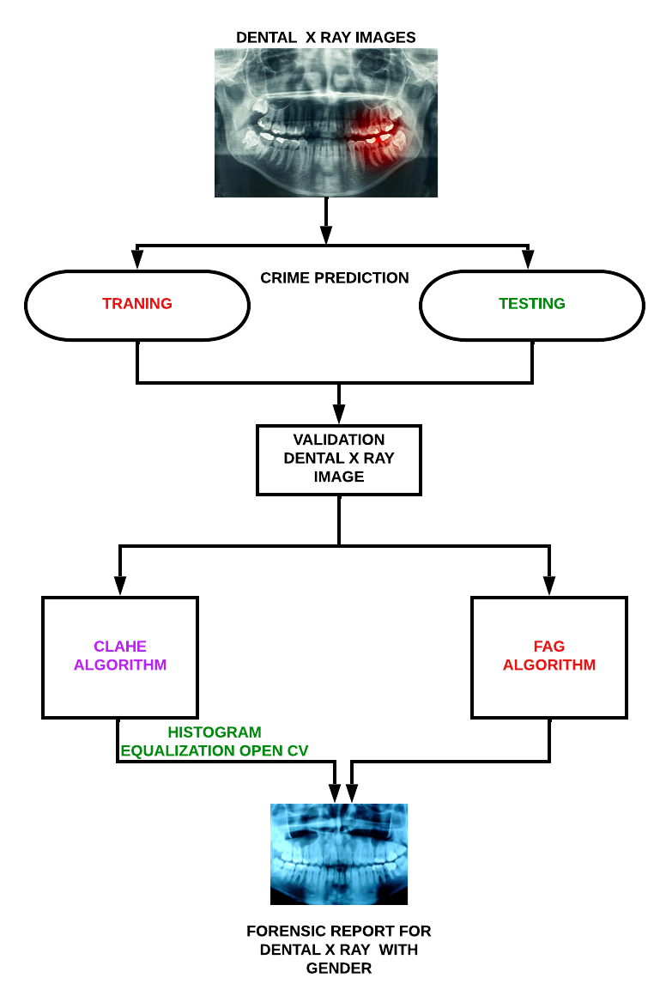
SYSTEM ARCHITECTURE

Slide 7
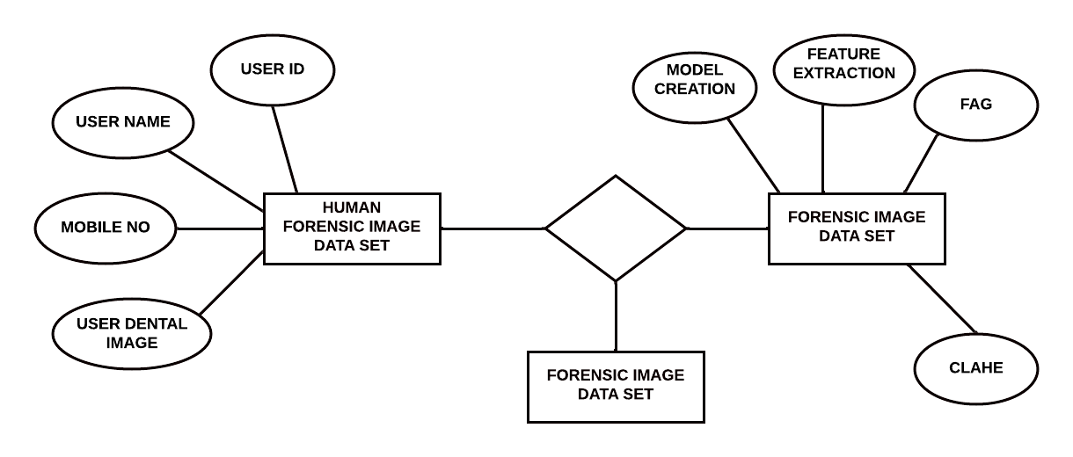
E-R DIAGRAM
HAS

Slide 8
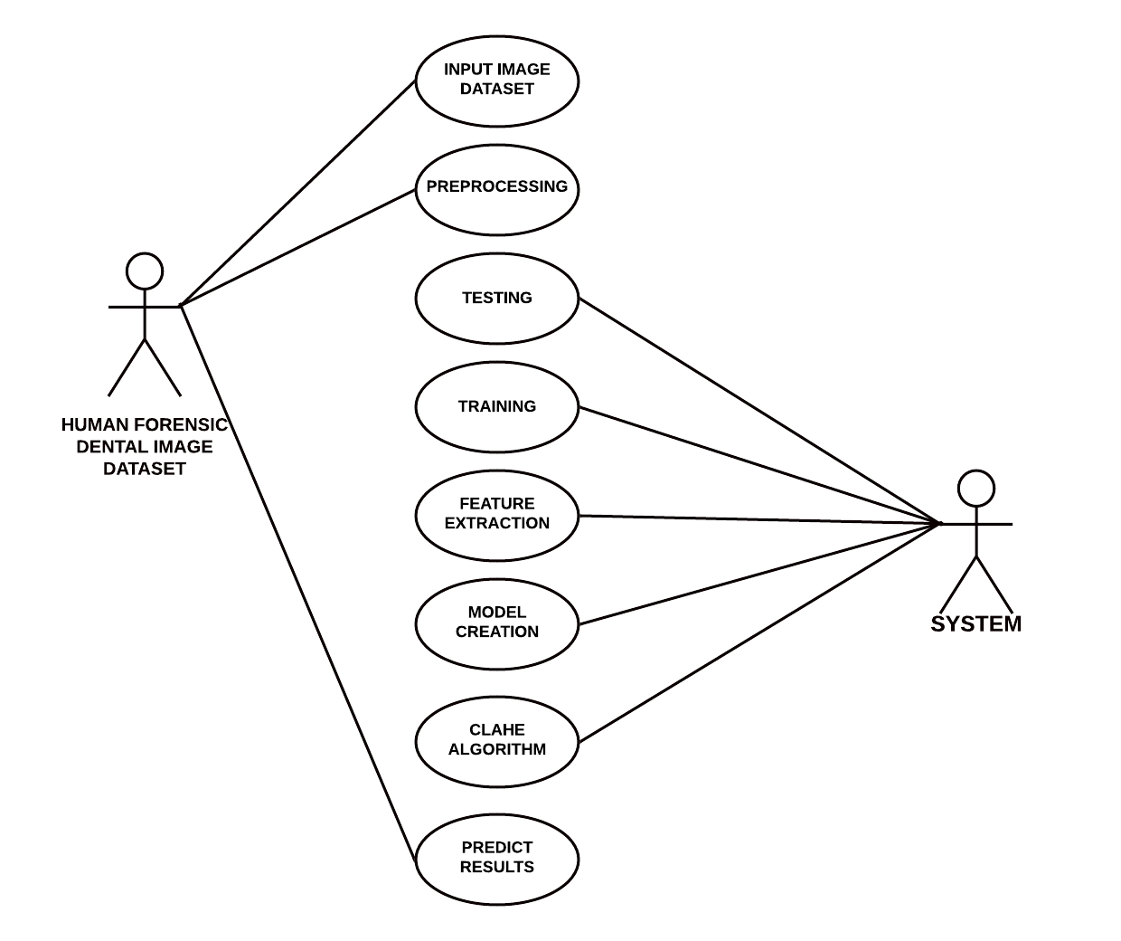
USE CASE:

Slide 9
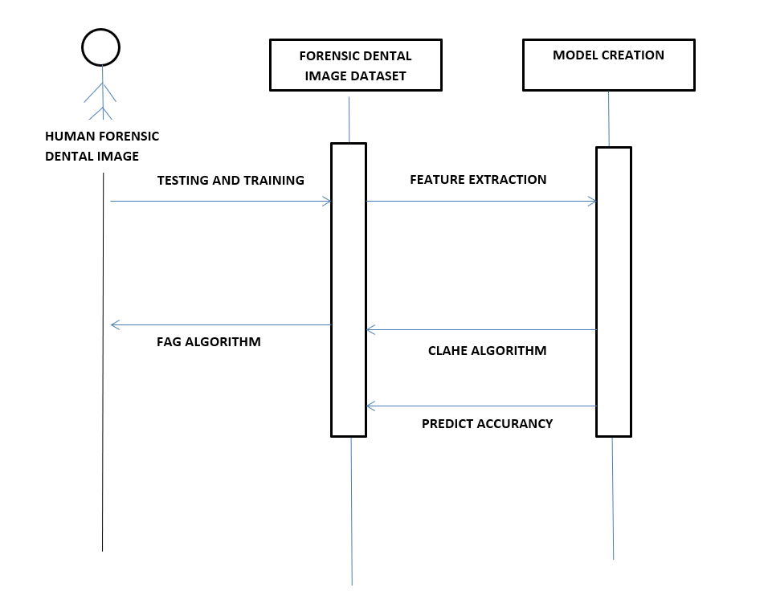
SEQUENCE DIAGRAM:

Slide 10
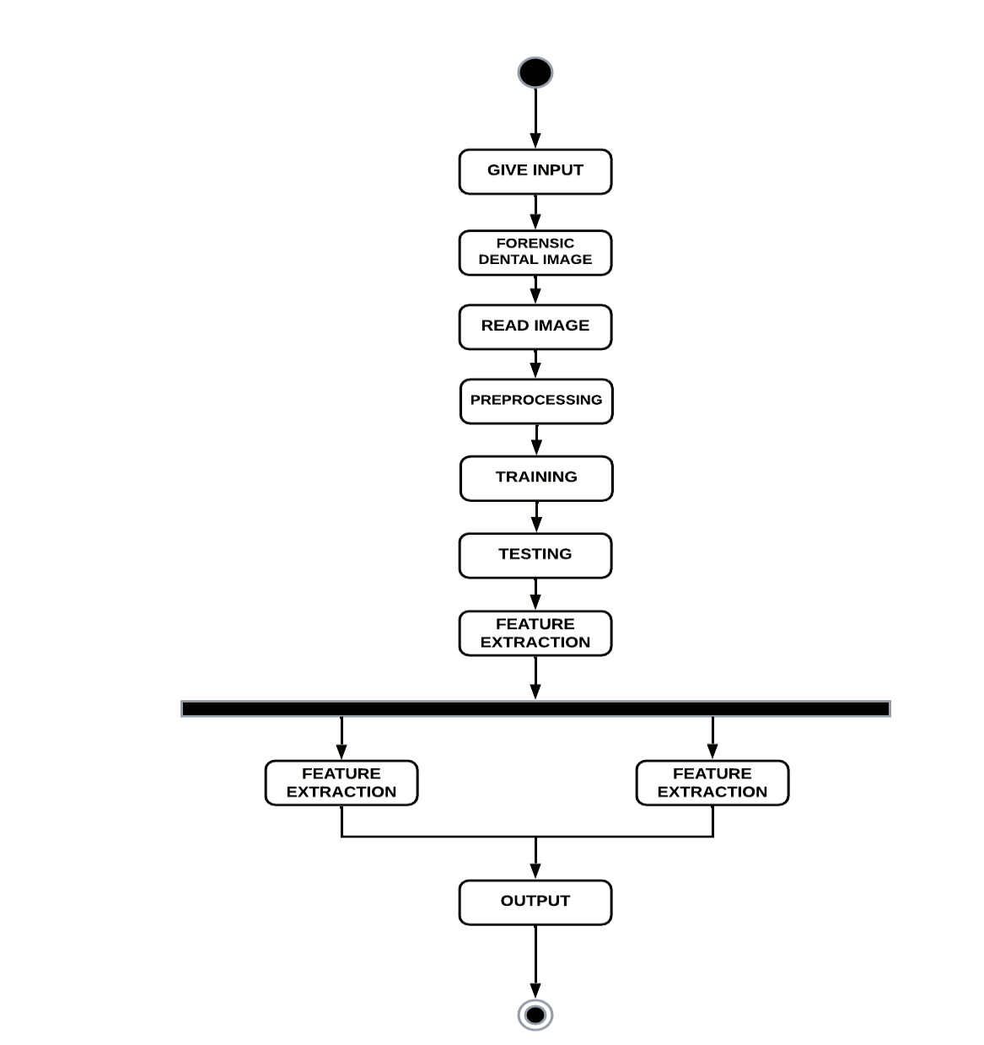
ACTIVITY DIAGRAM:

Slide 11
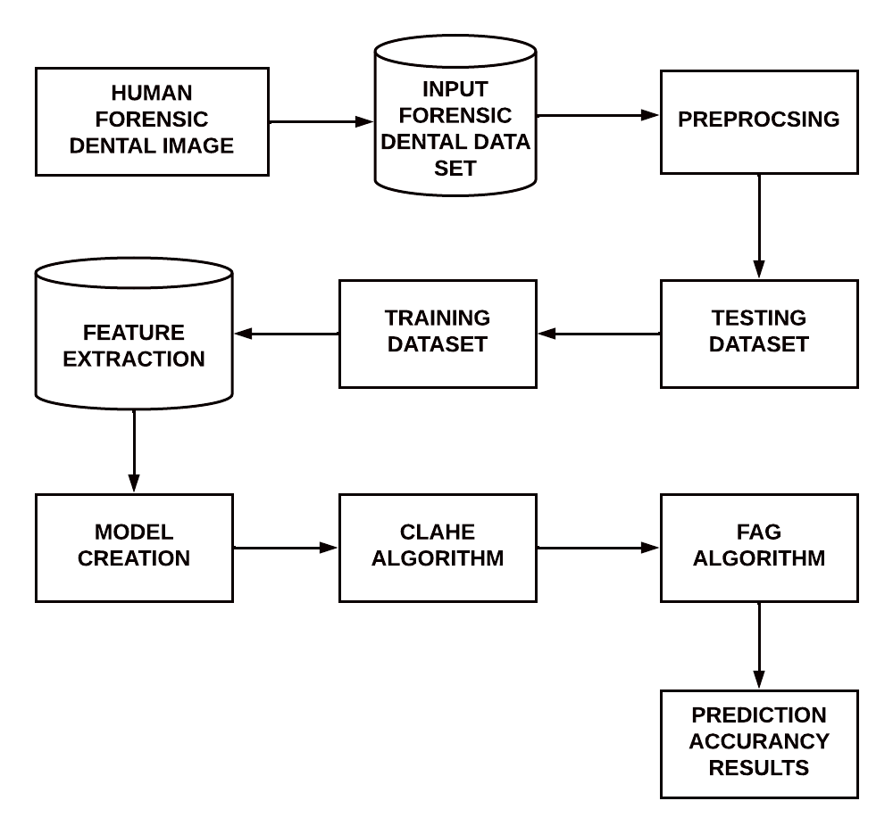
DFD DIAGRAM

Slide 12
1. DATA GENERATION USING BALANCING IMAGE
2. FORENSIC FREQUENCY PREDICTION BY CLAHE
3. FORENSIC FREQUENCY PREDICTION USING DENTAL IMAGE
4. LATENT PART LOCALIZATION
5. CONTRASTIVE LEARNING WITH DSA
MODULES, DESIGN AND SPECIFICATION LIST OF MODULES

Slide 13
DATA GENERATION USING BALANCING IMAGE
A police-department demand for the preparation of this rhetorical prediction model is that it forecast residential felony over area and time.consequently, the model classifies burglaries monthly across a regular dental image.
The dental image divides town into checkerboard-like cells. At intervals every cell, information is aggregate into dental rhetorical prediction.
Every cell is inhabited on a monthly basis. The space is over one-quarter mile square. In each cases, every monthly information set may be a matrixes of six antecedently mentioned classes.
The finer resolutions permits the dental image to be interrogated with lot of elaborate eye toward the spatial data inherent within the dataset. Conversely, the lower resolution has the impact of generalizing the spatial data. It ought to be noted that although this will increase the score of dental image classification, the general accuracy of the prediction is diminished attributable to the ensuing misclassification of cold spots.

Slide 14
FORENSIC FREQUENCY PREDICTION USING DENTAL IMAGE
The only difference is the addition of the dental Forensic prediction attribute; an instance represents the frequency of Forensic in a particular month, for a particular FAG algorithm and postcode, and for a particular Forensic type.
To find the correspondence between FAG algorithm and postcodes, the Office for National Statistics was used, which has a databases of dental images listing postcodes and their different output areas, including FAG algorithm.
This dental image database is from 2011.
The lower number of data objects in this dataset compared with the FAG algorithm is due to the information on the equivalence between the CLAHE and FAG algorithm.
Generally, postcodes areas cover several FAG algorithms, thus capturing information at a different geographical level which could potentially improve predictions.
In terms of the performance of the algorithm CLAHE and FAG algorithm have medium correlation coefficients, while the M5P algorithm has a strong correlation coefficient between the values predicted by the model and the real values.

Slide 15
LATENT PART LOCALIZATION
Dental image rhetorical prediction elements square measure vital personally rhetorical. The explored rigid body elements to develop strong options.
However, because of the dissatisfactory pedestrian detection algorithms and huge dental variations, the tactics of exploitation rigid body elements for native feature learning isn't the best answer. once exploitation rigid body elements, the highest half consists of enormous quantity of background.
This motivates United States to be told and localize the pedestrian elements mechanically. we have a tendency to integrate CLAHE and FAG formula because the half localization internet in our projected model.
The initial CLAHE is projected to expressly learn the image transformations parameters, like translation and scale. it's two main advantages: (1) it's absolutely differentiable will|and may|and might} be simply integrated into existing deep learning frameworks (2) it can learn to translate, scale and crop or warp a noteworthy regions while not to express region annotation.
These facts create it terribly appropriate for pedestrian elements localization.

Slide 16
FORENSIC FREQUENCY PREDICTION BY CLAHE
This experiment investigates the prediction of Forensic frequency by CLAHE algorithm. The procedure used in the experiment, outlining the four middle steps of the CLAHE algorithm methodology data understanding, data preparation, modeling and evaluation.
The first stage in the Data Understanding step was to integrate the data into one dataset by aggregating the monthly files.
All experiments started with this dataset.
For the purpose of this experiment, the frequency per month, per CLAHE algorithm, for each Forensic type was computed an instance represents the frequency of Forensic for a particular month, CLAHE algorithm and Forensic type.
This aggregation meant that some of the attributes that were relevant for individual Forensic became irrelevant for a monthly record of Forensic frequency.
These attributes are: Forensic ID, age, father name, Forensic details in the dataset for this experiment included attributes: The instances from the original dataset that had missing values for CLAHE algorithm name were excluded.

Slide 17
CONTRASTIVE LEARNING WITH DSA
We hand out FoID by 1st describing its building elements then the multi-task learning strategy. FoID maps every scan instances into associate degree embedding. Given a question instance, we tend to calculate the similarities between the question and every one the gallery instances within the embedding house and come back the graded retrieval list. to attain effective illustration learning, augmentations that cowl the potential anatomical variations as in clinics is that the key. The planned DSA consists four kinds of parameters impressed by rhetorical observations, and is severally applied to every attention patch on the fly.
(i) Random tooth reduction that aims to simulate tooth loss caused by injury or inventions
(ii) Random physical object addition that adds patches of versatile shapes to crown or tooth regions such augmentation aims to simulate the common artifacts of dental filling, implant, and brace.
(iii) Random rigid patch rework at intervals a spread of angles and displacements. The augmentation not solely enforces read comparison as within the commonplace instance discrimination learning, however conjointly simulates world teeth arrangement changes, since the rework is performed for patches severally.
(iv) Random colour disturbance of distinction shifting and Gaussian noise at intervals designed ranges for simulating totally different scanning setup and machine noises. additional details concerning the implementation of DSA area unit enclosed.

Slide 18
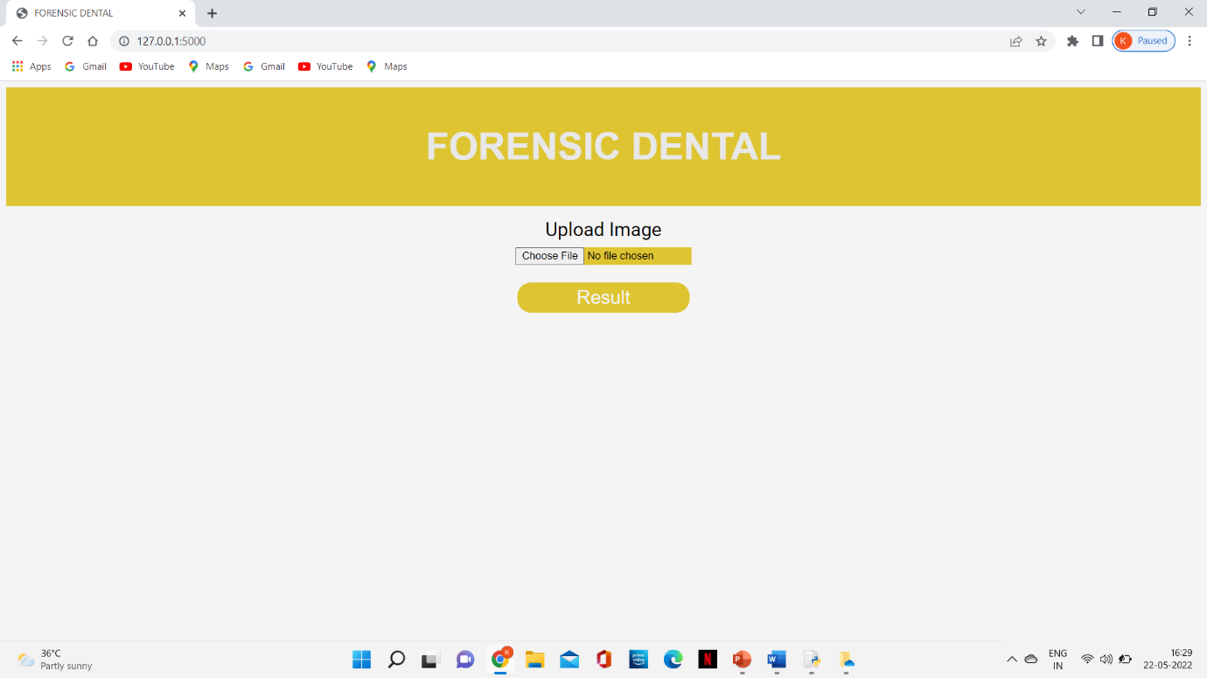

Slide 19
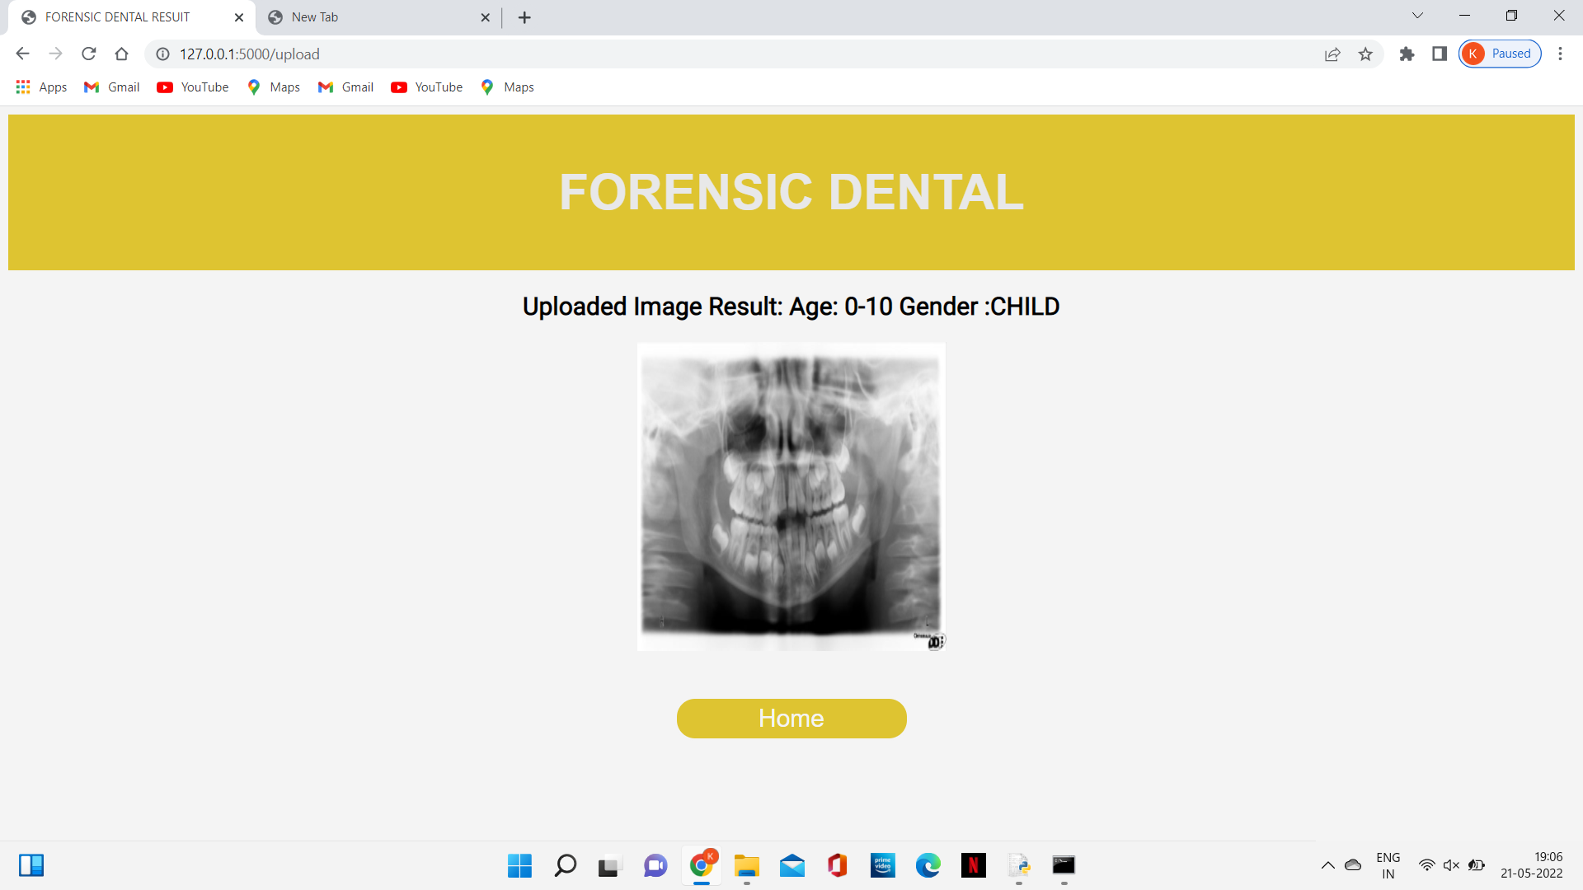

Slide 20
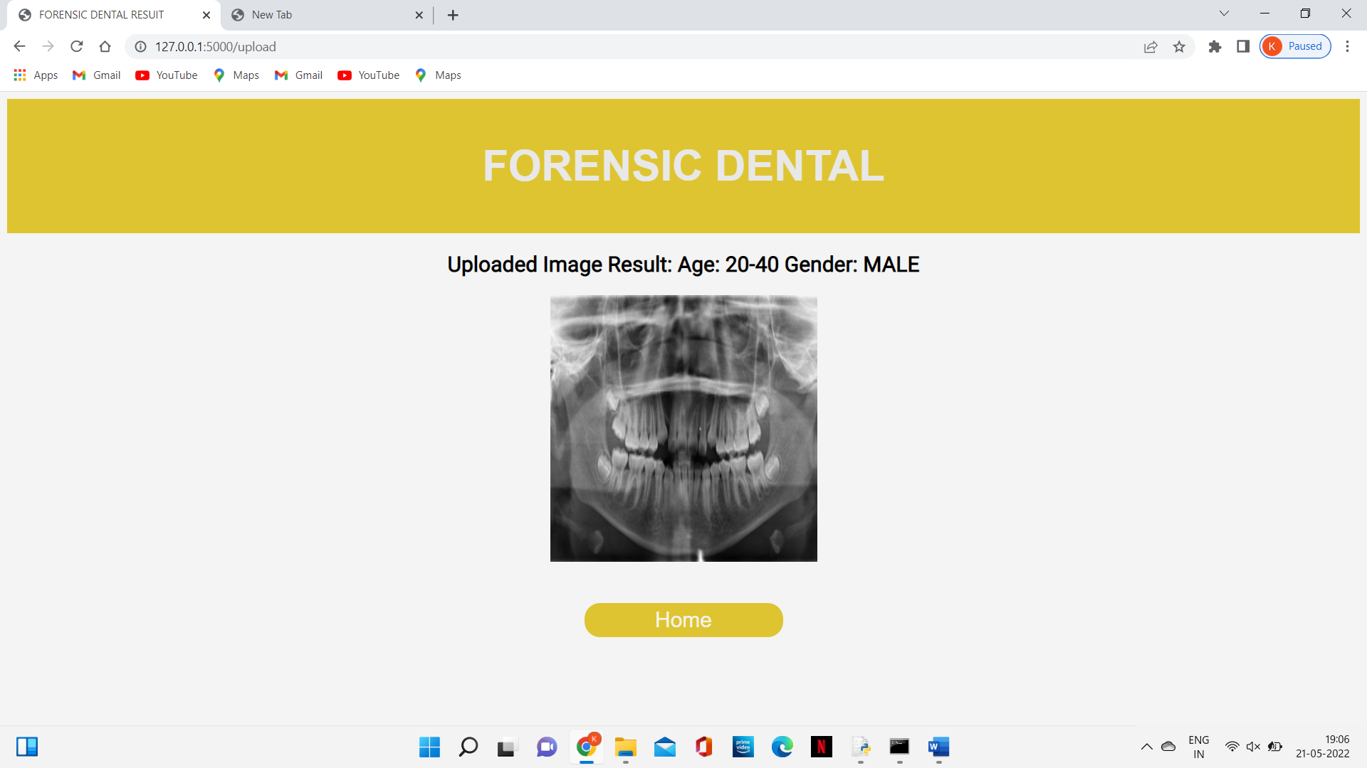

Slide 21
CONCLUSION
Now a day’s rhetorical dental image dataset prediction. rhetorical dental is an element of human activities and desires to be managed.
No human society has ever been entirely freed from deviants and it's unlikely that society can ever be.
This application is created to figure proficiently and viably. It leads to customary and auspicious activity against wrong doing careful.
It tends to be seen that the image information set is nonheritable effortlessly and exactly.It
By utilizing these application individuals who are apprehensive have enough time to go forensic dental image dataset for grievances about their own legitimate issues, or any sort of issues, here they can give their dissensions through forensic to enlist any kind of protests

Slide 22
REFERENCES:
[1] Zhivuan Zhang, Xin Zhong(2020), “3D Dental Biometrics Automatic Pose-invariant Dental Arch Extraction and Matching”
[2] Jingxuan Bao, Mansu Kim, Qing Sun, Anderson T. Hara , Gerardo Maupome and Li Shenk(2020),” Estimating Hard-tissue Conditions from Dental Images via Machine Learning”
[3]Mohamed Heshem , Monis Luquman Mohamed, Ahmed E. Youssef(2020),” Improving the Efficiency of Dental Implantation Process Using Guided Local Search Models and Continuous Time Neural Networks With Robotic Assistance”
[4] S. Sivagami, P. Chitra, G. Sri Ram Kailash, and S.R. Muralidharan(2020),” UNet Architecture Based Dental Panoramic Image Segmentation”’
[5] Sindu Divakaran, K. Vasanth, Suja D, Swedha V(2021),” Classification of Digital Dental X-ray Images Using Machine Learning”

Slide 23
[6] Dhruv Verma , Dr Sunaina Puri , Dr Srikanth Prabhu and Dr Komal Smriti(2021),” Anomaly detection in panoramic dental x-rays using a hybrid Deep Learning and Machine Learning approach”
[7] G.jaffino, A.Banumathi, j.prabin jose(2021),” Dental work extraction for different radiographic Images in human Forensic Identification”
[8] Anil Gurses, Ayse betul oktay(2021),” Tooth Restoration and Dental Work Detection on Panoramic Dental Images via CNN”
[9] Danijela Kalibovic Govorko, Benjamin Benzon, Katarina(2021),” Conventional vs. Digital dental impression: practitioner’s and patient’s perspective-a pilot study”
[10] Tomoko yui, Tomoki Ishikura, SungGwi Cho(2021),” : A Quantitative Measurement of Hand Scaling Motion for Dental Hygienist Training”

